Slide 1

COMP 491/L Senior Design Project Spring 2023 491/L Project Presentation
Group Name: White Volley Girls
Team Leader: Christian Jarmon

Slide 2
Agenda
(Project Overview)
(Problem Definition)
(Software overview diagram and explanation)
(Software Requirements)
(Software Testing Methodology)
(App Demo)
(Lessons Learned)
(Questions)

Slide 3
Project Overview
A full-stack application of tools and utilities for CSUN students and advisors to effectively plan and explore classes, schedules, professors, and majors provided by the university.

Slide 4
Problem Definition
Our goal was to gather, defragment, and organize all the information of catalogs, professors, majors, and school rules/guidelines.
Allows any and all to effectively plan one’s journey traversing CSUN.

Slide 5
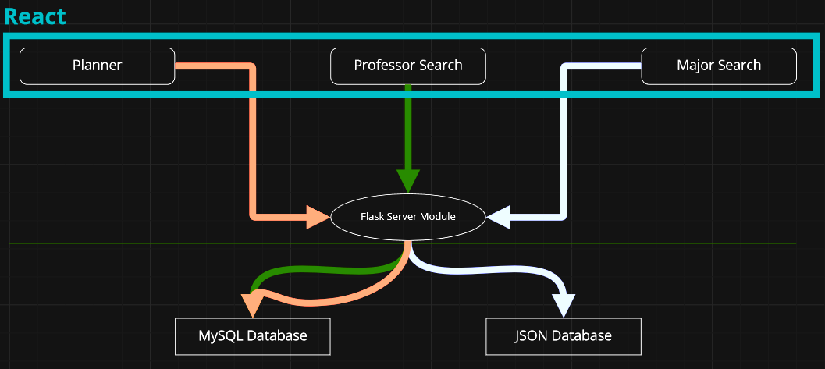
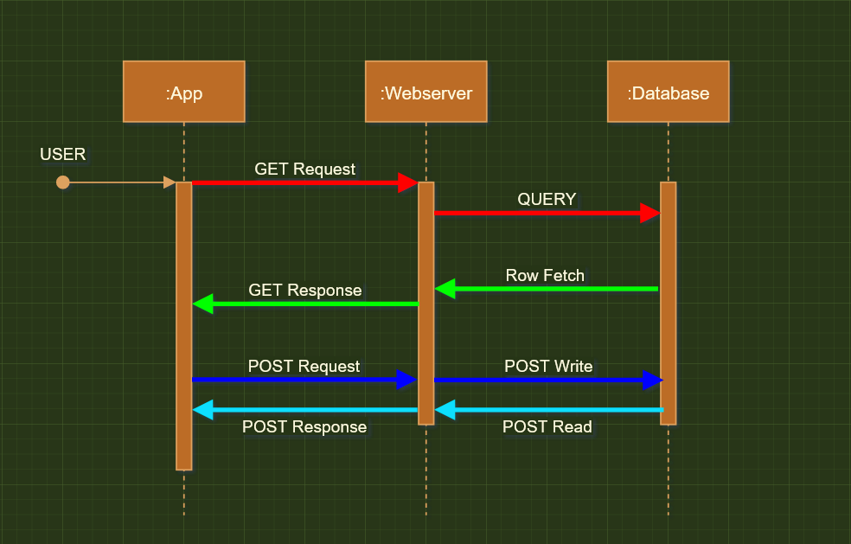
Software Overview
<= Components
Sequence Diagram =>

Slide 6
Software Requirements
FUNC_SRS_(1.0) – The program shall have 3 distinct pages: Class Planner, Professor Viewer, Major Explorer
FUNC_SRS_(2.0) - The Class Planner shall allow the user to explore classes and create possible schedules for a given semester
FUNC_SRS_(2.1) - The Class Planner shall allow the user to pick classes and react as the user selects a class.
FUNC_SRS_(2.2) - The tool shall have dropdowns that allow the user to pick a subject and have it display all the sections available for that subject in a pre-chosen semester.
FUNC_SRS_(2.3) - If the user attempts to pick a class that conflicts with an already chosen class, it shall warn the user that the schedule would be invalid.
FUNC_SRS_(2.4) - Per class chosen, the tool shall show the user the tuition cost of their current selections and should update on every addition or removal of a class
FUNC_SRS_(3.0) - The professor viewer shall allow the user to look at professors within a chosen department.
FUNC_SRS_(3.1) - The product shall allow users to rate a professor for a given class in a given subject.
FUNC_SRS_(3.2) - The viewer shall display contact information as available of professors within a department. The viewer will provide information available about a Professor as such.
FUNC_SRS_(4.0) - The major explorer shall allow the user to look at the class requirements for each major provided by CSUN.

Slide 7
Software Testing Methodology
Because I’m lazy, I opted for automated testing.
Used the Cypress testing framework for E2E testing
Split across 5 specs
home.spec.js
planner.spec.js
majors.spec.js
faculty.spec.js
ratings.spec.js
Unit Testing done in Python
Since the server was written in Python it was easier to test in with packaged testing suites that came with the Flask/FastAPI framework
Checks if each GET endpoint returned a status code of 200
POSTS returned a 405 status code when you attempt to visit the URL mapped to each endpoint

Slide 8
App Demo

Slide 9
Lessons Learned
Don’t couple your deployment strategy with the frameworks you use
Made it hard to switch from Flask to FastAPI
Don’t allow the terrible solution to work better than the better solution
Every request in Flask ties up the worker that listens for requests
Database was not redundant
Since Flask doesn’t handle multiple requests at once, the database was never simultaneously queried (which in practice is supposed to be allowed to happen)
So, 5000 synchronous requests completed faster (and with more success) than the 5000 asynchronous requests (FastAPI)

Slide 10

Questions?

